Slide 1

Site Reliability Engineering (SRE)
Anitha S

Slide 2
Prerequisites
Microsoft Azure
Azure Devops/(CI/CD)
IAC(Terraform/Pulumi/Bicep)
Visual Studio Code/Visual Studio
Monitoring (Datadog/Dynatrace)
Pagerduty

Slide 3

Scenario
Case Study | Design a Solution, ensuring it’s available, reliable and monitored
Notes:
Your company is launching a shopping list web app. Through the site, customers can add, edit, view, and remove items such as food and household needs from their list.
The site and APIs need to be secure to ensure customer privacy. Your users will be distributed all over the world, and you want everyone to get great performance. You'd prefer a solution that removes as much of the infrastructure work, including building and publishing, as possible so you can concentrate on features and user experience.
You could deploy your web assets to cloud storage, create, and assign your own SSL certificate, create your API on a cloud server, establish a reverse proxy that allows your app to make calls to the API, distribute the app globally, and set up your own CI/CD process.
When you use Azure Static Web Apps, you get all of this out of the box.

Slide 4
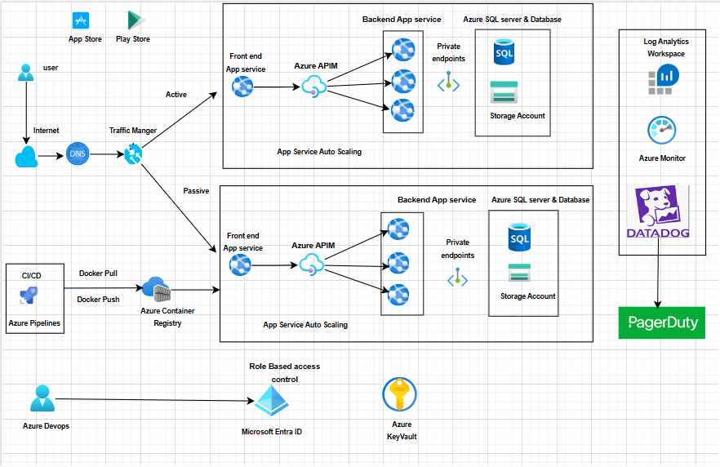
Architecture – Web application deployment using App service

Slide 5
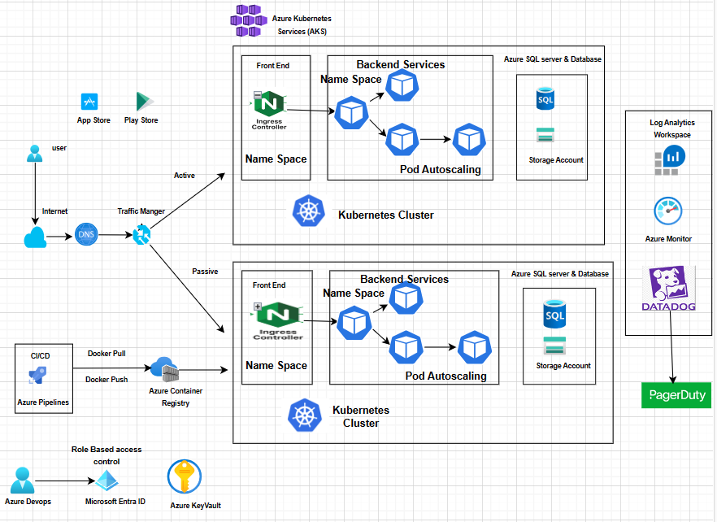
Architecture – Web application deployment using AKS

Slide 6
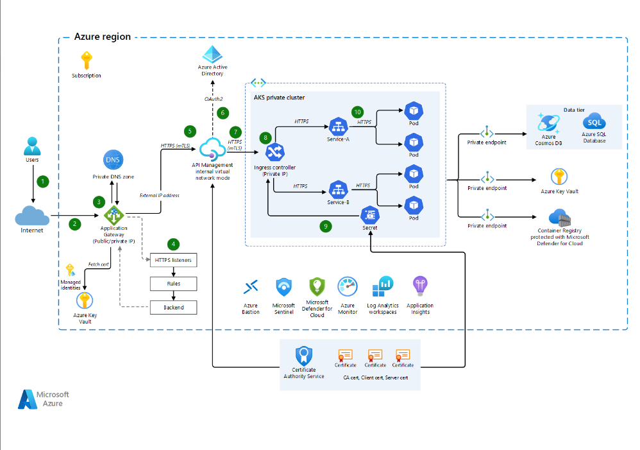
Architecture – From Microsoft

Slide 7
Frontend API management 1. We can put API management in frontend.( internet request directly hit azure API management). 2. When API’s are consuming by other applications by our B2B customers, in the case we will put API management is frontend.
Middle API management
1. In the below scenarios, we will put API management service between frontend application and our multiple API’,
2. If our API’s are not used third party applications from internet in that case we will put API management service between frontend and backend API’s

Slide 8
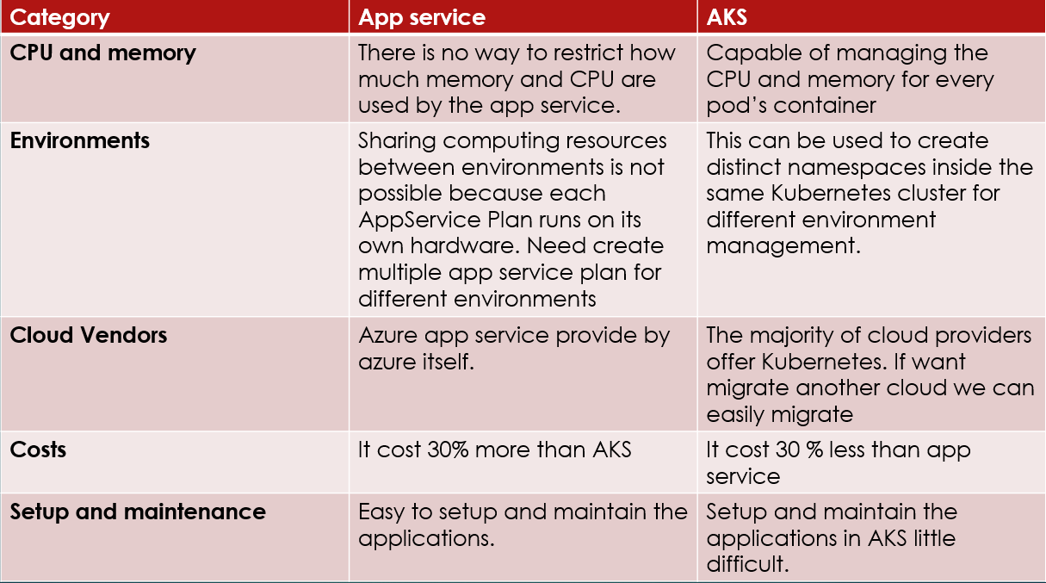
AppService vs AKS

Slide 9
When to choose App Service 1. When we need the solution in PAAS service in cloud. 2. Azure App Service is an excellent choice for various scenarios, primarily when you require a straightforward and managed platform to host and deploy web applications, APIs, or mobile backends.
When to choose Azure AKS
Choose Azure Kubernetes Service when dealing with complex applications, containerized workloads, microservices architecture, and when you need fine-grained control over your infrastructure and deployment strategy. AKS is well-suited for enterprises that need flexibility, efficiency, and scalability for their container-based applications.

Slide 10
Thank you
QA

